Slide 1
Can one predict the 2019 MLB Champion?
Capstone Project
Daniel Duncum

Slide 2
Introduction/Hypothesis:
 | Champion | Wins | Losses | Ties | WinRatio | PayrollRank | WinsAboveReplacement | WARRank
1992 | Toronto Blue Jays | 96 | 66 | 0 | 0.593 | 1 | 9.2 | 5
1993 | Toronto Blue Jays | 95 | 67 | 0 | 0.586 | 1 | 10.8 | 5
1995 | Atlanta Braves | 90 | 54 | 0 | 0.625 | 4 | 12.5 | 2
1996 | New York Yankees | 92 | 70 | 0 | 0.568 | 1 | 9.1 | 5
1997 | Florida Marlins | 92 | 70 | 0 | 0.568 | 5 | 7.4 | 7
1998 | New York Yankees | 114 | 48 | 0 | 0.704 | 2 | 25.7 | 2
1999 | New York Yankees | 98 | 64 | 0 | 0.605 | 1 | 15.3 | 3
2000 | New York Yankees | 87 | 74 | 0 | 0.54 | 1 | 3.6 | 13
2001 | Arizona Diamondbacks | 92 | 70 | 0 | 0.568 | 8 | 17.8 | 3
2002 | Anaheim Angels | 99 | 63 | 0 | 0.611 | 15 | 17.8 | 3
2003 | Florida Marlins | 91 | 71 | 0 | 0.562 | 25 | 8.2 | 8
2004 | Boston Red Sox | 98 | 64 | 0 | 0.605 | 2 | 16.4 | 2
2005 | Chicago White Sox | 99 | 63 | 0 | 0.611 | 13 | 8.8 | 10
2006 | St. Louis Cardinals | 83 | 78 | 0 | 0.516 | 11 | 0.5 | 17
2007 | Boston Red Sox | 96 | 66 | 0 | 0.593 | 2 | 22.3 | 1
2008 | Philadelphia Phillies | 92 | 70 | 0 | 0.568 | 12 | 11.7 | 4
2009 | New York Yankees | 103 | 59 | 0 | 0.636 | 1 | 19 | 1
2010 | San Francisco Giants | 92 | 70 | 0 | 0.568 | 10 | 13.4 | 2
2011 | St. Louis Cardinals | 90 | 72 | 0 | 0.556 | 9 | 6.4 | 7
2012 | San Francisco Giants | 94 | 68 | 0 | 0.58 | 7 | 7.6 | 9
2013 | Boston Red Sox | 97 | 65 | 0 | 0.599 | 3 | 20 | 1
2014 | San Francisco Giants | 88 | 74 | 0 | 0.543 | 6 | 2.8 | 13
2015 | Kansas City Royals | 95 | 67 | 0 | 0.586 | 13 | 6.8 | 8
2016 | Chicago Cubs | 103 | 58 | 1 | 0.639 | 5 | 25.7 | 1
I have been exploring and looking at data from 24 years of Major League Baseball World Series Champions(1992-2006) in an effort to be able to analyze if you can use certain data to determine if your team has a chance to win the championship in any given year. I am using ggplots to chart out certain data points versus each other to see if there is any correlation to better make that determination of if your team does stand a chance based upon historical information. By analyzing these plots you can find certain statistics that these past champions have and be able to run logistical regression to find your champion of 2019.

Slide 3
Data set Explanation
I originally chose this data set from data I found on Data World and Baseball-Reference, and was able to wrangle it down and add new variables to help me run the data through ggplots and eventually Logistical Regression to determine the 2019 World series Champion. I originally had all the champions from 1903-2016 but I decided to trim it down to the last 25 years so this is right before expansion started in 1992/1998. I used strategies like Spread to separate the win and loss to create the win ratio column which is the teams win percentage (win/total games played).

Slide 4
Data Set Variables
So I decided that this data needed more variables to help determine the 2019 champion. So I added Payroll Rank, WAR, and WAR Rank to help showcase who is going to win the title.
Payroll rank came from Baseball-Reference, which I was able to see how much teams spent compared to other 30 teams. This includes all players or player they have cut or traded and keep paying their salary on other teams or while player is just at home.

Slide 5
Data Set Variable
WAR
Wins Above Replacement or WAR, is a non standardized sabermetric baseball statistic developed to sum up "a player's total contributions to his team".[1] A player's WAR value is claimed to be the number of additional wins his team has achieved above the number of expected team wins if that player were substituted with a replacement-level player: a player who may be added to the team for minimal cost and effort
This data was pulled from Baseball-Reference and shows the total added WAR for all players that played that given year for the their respective championship team.
I also then went on Baseball-Reference and pulled the data on where the Championship teams WAR ranked them among the 30 other teams in the league to see if that makes a difference to be in the upper level of the league or not in their championship year.

Slide 6
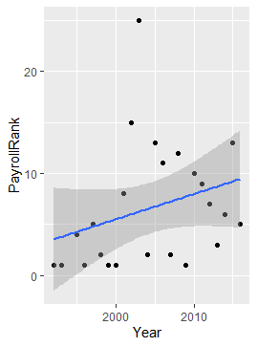
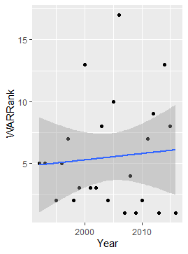
Ggplots to analyze data
ggplot(Regular_Season_Winning_Percentages_of_MLB_World_Series_Champions_1992_2016, aes(x=Year, y=PayrollRank)) + geom_point() + geom_smooth(method="lm")
ggplot(Regular_Season_Winning_Percentages_of_MLB_World_Series_Champions_1992_2016, aes(x=Year, y=WARRank)) + geom_point() + geom_smooth(method="lm")

Slide 7
Gg Plot Analysis
Payroll rank vs year
WAR Rank vs year
I compared these 2 variables to see if Payroll Ranking had a trend in Championship teams, and after looking at the plot it most certainly does. 24/25 champions were in the top 15 teams in that year (top 50%). So that seems to be a eliminating factor. More money spent equates to more win and more titles.
I compared these 2 variables to see if WAR Ranking had a trend in Championship teams, and after looking at the plot it most certainly does. 22/25 champions were in the top 10 teams in that year (top 33%). So that seems to be a eliminating factor. This shows us that of course the better your players play the more WAR you have and therefore rank higher and possibly win a championship. But this also shows us that if you make a mid season trade that the player traded for needs to be of highest caliber to produce WAR on his new team and help said team win the title.

Slide 8
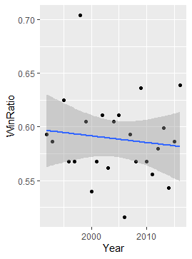
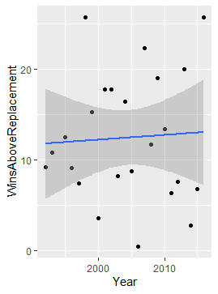
Ggplots to analyze data
ggplot(Regular_Season_Winning_Percentages_of_MLB_World_Series_Champions_1992_2016, aes(x=Year, y=WinRatio)) + geom_point() + geom_smooth(method="lm")
ggplot(Regular_Season_Winning_Percentages_of_MLB_World_Series_Champions_1992_2016, aes(x=Year, y=WinsAboveReplacement)) + geom_point() + geom_smooth(method="lm")

Slide 9
Gg plot Analysis
Win Ratio vs year
WAR vs year
After looking at this Gg plot, it seems to be that a win ratio of 0.55 (55% win percentage) is a good deciding factor to see if your team is a championship contender, as 22/25 previous champions are above that threshold. Win Ratio is also a good variable to determine this years title contender. This is because the higher your win ratio the better playoff seeding you get and therefore get home field advantage in your playoff series. This is crucial as most home stadiums carry an added level of win percentage to them as the home fans can either pump you up as the home team or mess with you as the visitor.
This plot is just showing that 22/25 champions had at least 5 WAR in the year they won their title. This is a measure of pitching/defense/hitting that could determine how the manager plays certain players against certain teams to try and increase his odds of winning. It also could help the front office try and determine what players they need to add at the trade deadline to fill possible deficiencies.

Slide 10
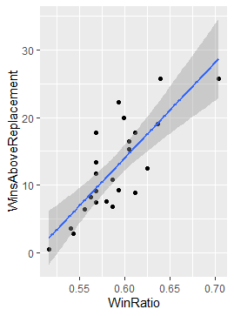
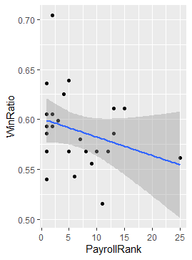
Ggplots to analyze data
ggplot(Regular_Season_Winning_Percentages_of_MLB_World_Series_Champions_1992_2016, aes(x=WinRatio, y=WinsAboveReplacement)) + geom_point() + geom_smooth(method="lm")
ggplot(Regular_Season_Winning_Percentages_of_MLB_World_Series_Champions_1992_2016, aes(x=PayrollRank, y=WinRatio)) + geom_point() + geom_smooth(method="lm")

Slide 11
Gg plot analysis
WAR vs Win Ratio
Win Ratio vs Payroll Rank
I wanted to compare these 2 variables to see any correlation and of course there is. The higher the WAR the higher your win ratio is. This shows us that players have great seasons to help their teams win and move on into championship contention and then win a title.
Again another comparion to see if actually spending more money does equate to more wins. So if one looks at the mean “blue” line, it does show that as Payroll Rank is higher(closer to being the number 1 highest spending team) so is win ratio. So spending more money doesn’t hurt except the owners wallet.

Slide 12
Plot Analysis
From this analysis it shows that to be World Series champion, you need to follow the simple steps of being in the top 3rd in league in WAR Rank, top half of league in Payroll Rank, and win above 55% of your games and you should have a good statistical chance of playing for the title.
As this is tricky variable term, WAR stands for: Wins Above Replacement or WAR, is a non standardized sabermetric baseball statistic developed to sum up "a player's total contributions to his team".^{[1]} A player's WAR value is claimed to be the number of additional wins his team has achieved above the number of expected team wins if that player were substituted with a replacement-level player: a player who may be added to the team for minimal cost and effort

Slide 13
Can we predict champion?
First step would be to use Plot Analysis to eliminate teams based off that analysis and determine what variables are most important:
0.54 WinRatio needed eliminates: Cardinals, Cubs, and Nationals
Top 3rd WAR Rank eliminates: Braves
Top 50% Payroll Rank eliminates: Twins, Indians, Rays
So by that Analysis that should leave the Dodgers, Yankees, and Astros with the best chances but we are going to run logistical analysis on the entire 2019 Playoff field to help us see if that is correct.
We have added 2017 and 2018 data to the 2019 data of the playoff teams to allow us more variables to be able to better predict the champion. Then ran a matchup based Logistic Regression based off those 3 years worth of data. Both methods: Ggplot analysis and Logistic regression show similar results.

Slide 14
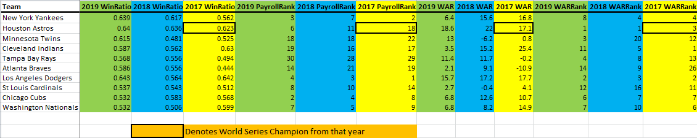
Logistical Regression of 2019 Playoff Teams
In this data, I have put the 2019 Playoff Teams (as of now) with the same variable as earlier but also added the 2017 and 2018 data in those same categories to allow us to run a better logistical regression model to predict the champion better.

Slide 15
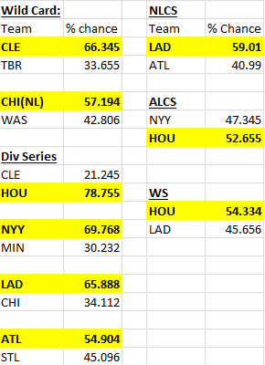
Logistic Regression to Predict 2019 Champion
I used an article I found on Github discussing best Machine learning methods to predict NCAA Tourney and by using certain R coding they broke down each matchup and then moved that “winning” team on to next round. I have applied same approach here. As Major League baseball playoffs are like the NCAA Tourney with each team facing off to move on to the next round. So I applied logistical analysis to determine each “matchup” winner and moved them on to the next round. I have found that the winner will be the Houston Astros over the Los Angeles Dodgers.
An example of how I ran each matchup with R coding using Logistic Regression
team1_name = ‘CLE' team2_name = ‘TBR’ team1_vector = getSeasonData(teams_pd[teams_pd['Team_Name'] == team1_name].values[0][0]) team2_vector = getSeasonData(teams_pd[teams_pd['Team_Name'] == team2_name].values[0][0])
print 'Probability that ' + team1_name + ' wins:', predictGame(team1_vector, team2_vector, 0)[0]

